Slide 1
Introduction to the Cell multiprocessor
J. A. Kahle, M. N. Day, H. P. Hofstee,
C. R. Johns, T. R. Maeurer, D. Shippy
(IBM Systems and Technology Group)
Presented by Max Shneider

Slide 2
Additional Information Source
This presentation also contains more general information on Cell, found here:
  Cell Architecture Explained, Version 2
  © Nicholas Blachford, 2005
  http://www.blachford.info/computer/Cell/Cell0_v2.html

Slide 3
Background Info – Caches
Small Size Large
Fast Speed Slow
Hard Drive
Memory
L2 Cache
L1 Cache
Registers

Slide 4
Background Info – Pipelining
5 stage pipeline (each stage
uses a different resource):
1 2 3 4 5
Instead of waiting for each instruction to complete before starting the next:
1 2 3 4 5
1 2 3 4 5
…
1 2 3 4 5
1 2 3 4 5
Overlap the instructions
to maximize resources:
1 2 3 4 5
1 2 3 4 5
1 2 3 4 5

Slide 5
Project History
Collaboration between Sony, IBM, and Toshiba initiated in 2000
STI Design Center opened in Austin, TX with joint investment of $400,000,000
Originally designed for PS3, 100x faster than PS2
  Since it’s general purpose, will be used for more than gaming (Blu-ray, HDTV, HD Camcorders, IBM servers)
  Mixture of broadband, entertainment systems, and supercomputers (hence the three companies)
Can think of it as:
  A computer that acts like cells in a biological system
  A supercomputer on a chip designed for the home

Slide 6
Program Objectives/Challenges
Outstanding performance, especially on game/multimedia applications. Limited by:
  Memory latency and bandwidth
    Problem is that processor frequencies are not met by memory latencies, getting worse everyday
      Worse for multiprocessors (~ 1,000 cycles) than single processors (100’s of cycles)
    In conventional processors, few concurrent memory accesses due to cache misses and data dependencies
    Want more simultaneous memory transactions (bandwidth)
  Power
    Cooling imposes limits on amount of power
    Need to improve power efficiency along with performance since no alternative lower-power technology is available

Slide 7
Objectives (cont.)
Real-time responsiveness to the user and network
  Primary focus is keeping player/user satisfied (not keeping the CPU busy) ⇒ need real-time support
  Since most Cell processor devices will be connected to the Internet, must be programmable and flexible to support wide variety of standards
  Concerns: security, digital rights management, privacy
Applicability to a wide range of platforms
  Game/media and Internet ⇒ wide range of applications
  Developed an open (Linux-based) software development environment to extend reach of the architecture
Support for introduction in 2005
  Based Cell on Power Architecture because 4 years was not enough to make a completely new design

Slide 8
Cell Architecture
Comprised of hardware/software cells that can co-operate on problems
Can potentially scale up and distribute cells over a network or the world
Performs 10x faster than existing CPUs on many applications
Similar to GPUs in that it gives higher performance, but can be used on a wider variety of tasks
Each individual cell can theoretically perform 256 GFLOPS at 4 GHz, with power consumption between 60-80 Watts

Slide 9
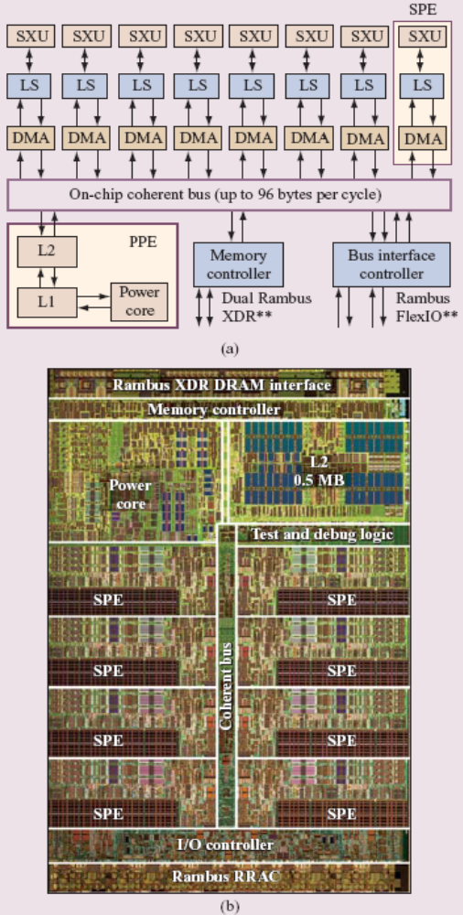
Cell Components
1 Power Processor Element (PPE)
8 Synergistic Processor Elements (SPEs)*
Element Interconnect Bus (EIB)
Direct Memory Access Controller (DMAC)
Rambus XDR memory controller
Rambus FlexIO (Input / Output) interface
PS3 will only have 7 SPEs, and consumer electronics will only have 6

Slide 10
PPE
Runs the operating system and most of the applications, but offloads computationally intensive tasks to the SPEs
64-bit Power Architecture processor with 32-KB Level 1 instruction/data caches and 512-KB Level 2 cache
Simpler than other processors
  Can’t do things like reordering instructions (in-order)
  But requires far less power (has less circuitry)
Can run two threads simultaneously (which means it keeps busy when one thread is stalled and waiting)
Erratic performance on branch-heavy applications (result of pipelining) – requires a good compiler
Composed of 3 units:
  Instruction unit (IU) – fetches/decodes instructions, includes L1 instruction cache
  Fixed-point execution unit (XU) – fixed point, load/store, and branch instructions
  Vector-scalar unit (VSU) – vector, floating point instructions

Slide 11
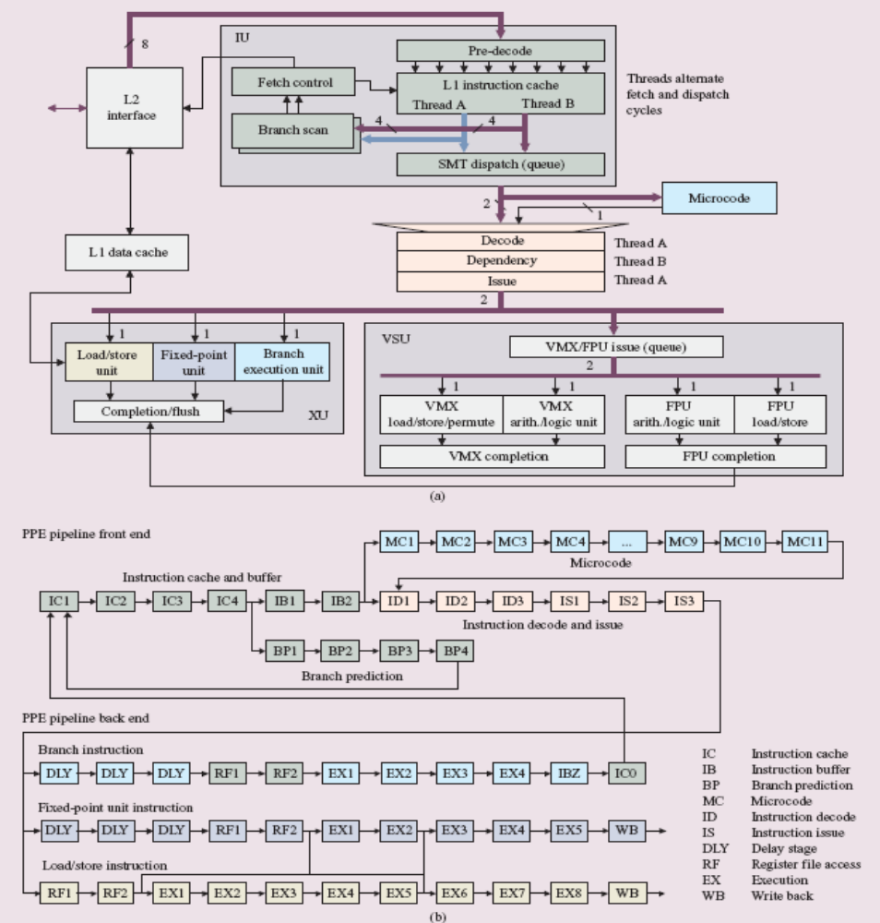
PPE

Slide 12
SPE
Each of the 8 SPEs acts as an independent processor
  Given the right task, can perform as well as a top end CPU
  32 GFLOPS (so 32 x 8 = 256 GFLOPS for system)
Each SPE has a 256-KB local memory store instead of cache (more like a second level register file)
  Less complex and faster, no coherency problems
  DMA transfers between local store and system memory
  Allows many simultaneous memory transactions
  Makes it easy to add more SPEs to the system
SPEs are vector processors – can do multiple operations simultaneously on same instruction
  Programs need to be “vectorized” to take full advantage (can be done with audio, video, 3D graphics, scientific applications

Slide 13
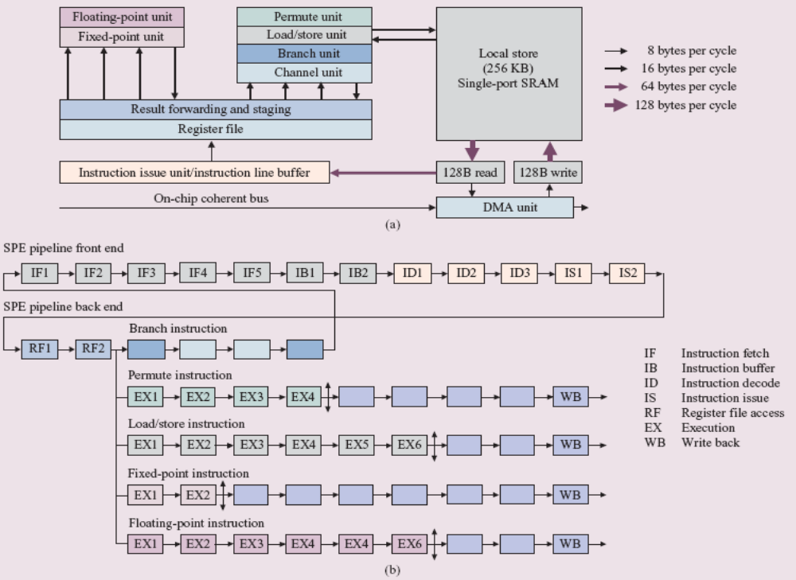
SPE

Slide 14
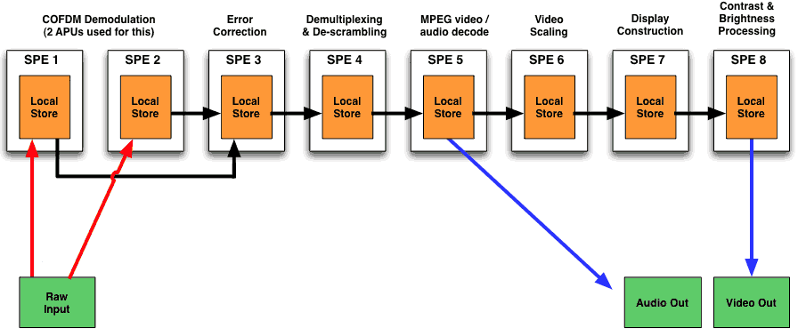
SPE Chaining (Stream Processing)
SPE reads input from its local store, does processing, and stores result back in its local store
  Next SPE can read output from first SPE’s local store, do processing, …
Absolute timer for exactly timed steam processing
Multiple communication streams between SPEs to allow this
  Internal SPE transfers: 100’s of GB/sec
  Chip to chip transfers: 10’s of GB/sec

Slide 15
Additional Cell Components
DMAC – controls memory access for PPE and SPEs
XDR RAM memory – Cell can be configured to have GB’s of memory.
  25.6 GB/sec bandwidth (higher than any PC, but necessary to feed SPEs)
EIB – connects everything together, allows 3 simultaneous transfers, peaking at 384 GB/sec
Rambus FlexIO interface – high bandwidth
(76.8 GB/sec) and flexible to support multiple configurations (dual-processors, 4-way multiprocessors, etc.)
IBM’s virtualization software – allows multiple operating systems to run at the same time

Slide 16
Additional Cell Components (cont.)
Power architecture compatibility –based on the Power architecture, so all existing Power applications can be run on the Cell processor without modification
Single-instruction, multiple data (SIMD) architecture
  SIMD units effectively accelerate multimedia applications
  They also have mature software support (since they’re included in all mainstream PC processors)
  SIMD units on the PPE and all SMEs
    Simplifies software development and migration
DRM-like security – Each SPE can lock most of it’s local store for it's own use only

Slide 17
Programming
Architecture is great, but can’t use it without software
Have to manage SPE local store memory manually (this could eventually be handled by compilers)
  More efficient, but additional complexity for developers
  Also, limited ability to change hardware in the future
Up to programmers to utilize SIMD units for best performance benefits
Primary development language is C with standard multithreading
Primary OS is Linux (since it already ran on the PowerPC)

Slide 18
Converting an Application to Cell
Requires the following steps:
  Port application to PowerPC instruction set
  Figure out which parts of the code should run on SMEs, make those self-contained
    Best suited for small, repetitive tasks that can be vectorized or parallelized
  Vectorize the code, use SIMD units properly, and balance data flow to make most efficient use of SPEs
Multiple execution threads, careful choice of algorithms and data flow control are all necessary (same as multi-processors)
Cell will still suffer from same things as a standard PC (ie. lots of random memory reads)
Must worry about size – algorithm and at least some of the data need to fit within the local store

Slide 19
Programming Models
Function offload – main application executes on PPE, offload complex functions to SPEs (currently identified by programmer, might be done by compiler in future)
Device extension – use SPEs as intelligent front-ends to external devices (can lock local store for security/privacy)
Computational acceleration – perform computationally intensive tasks on SPEs, parallelizing the work if necessary
Streaming – set up serial or parallel pipelines, as explained earlier (PPE controls, SPEs process)
Shared-memory multiprocessor – set up cell as a multiprocessor, with PPE and SPE units interoperating on shared memory
Asymmetric thread runtime – organize programs in threads that can be run on PPE or SPEs

Slide 20
Meeting the Design Objectives
Outstanding performance, especially on game/multimedia applications
  SPE local stores instead of caches, 256 KB in size to ease programmability
  SIMD model accelerates multimedia applications
  Considerable bandwidth and flexibility inside the chip
Real-time responsiveness to the user and network
  Can interact with individual SPEs through their DMAs
  Simplicity of SPEs (no cache, etc.) makes it easier to analyze their performance
Applicability to a wide range of platforms
  Can be used for a number of different purposes because of Linux (as opposed to a proprietary OS)
Support for introduction in 2005
  Met the goal by basing Cell on Power Architecture, which also helps compatibility.
  SIMD on PPE and SPEs eases programming

Slide 21
Future Potential
Multiple discrete computers become multiple computers in a single system
Upgrade system by enhancing it (adding more Cells), instead of replacing it
Your "computer" might include your PDA, TV, printer and camcorder (basically a network)
Moves hardware complexity to system software
  Slower, but provides more flexibility
OS takes care of system changes, programmer doesn’t need to worry about it

Slide 22
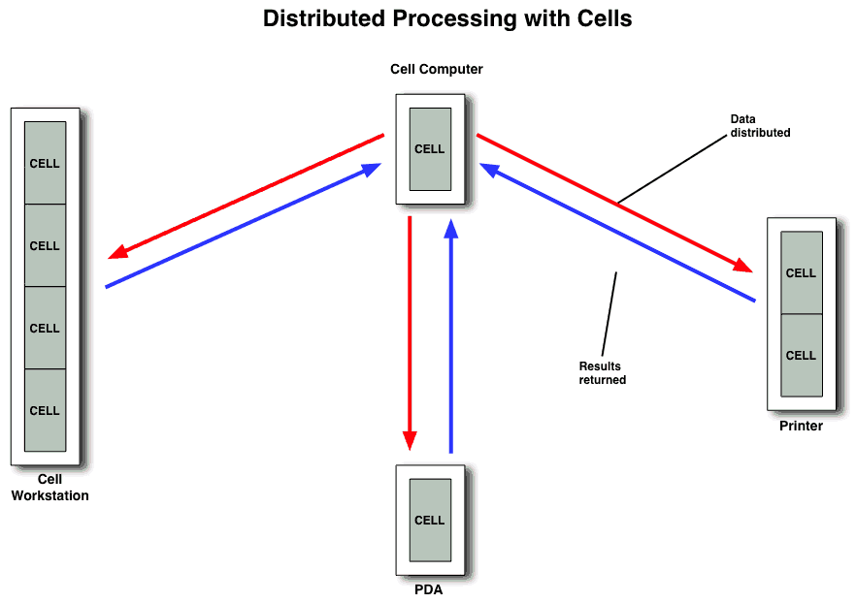
Future Potential (cont.)

Slide 23
Discussion
Any questions?

